Slide 1

Stop manually publishing your PowerShell modules
Automate it in 2 minutes!
Daniel Schroeder
@deadlydog
1 / 15

Slide 2
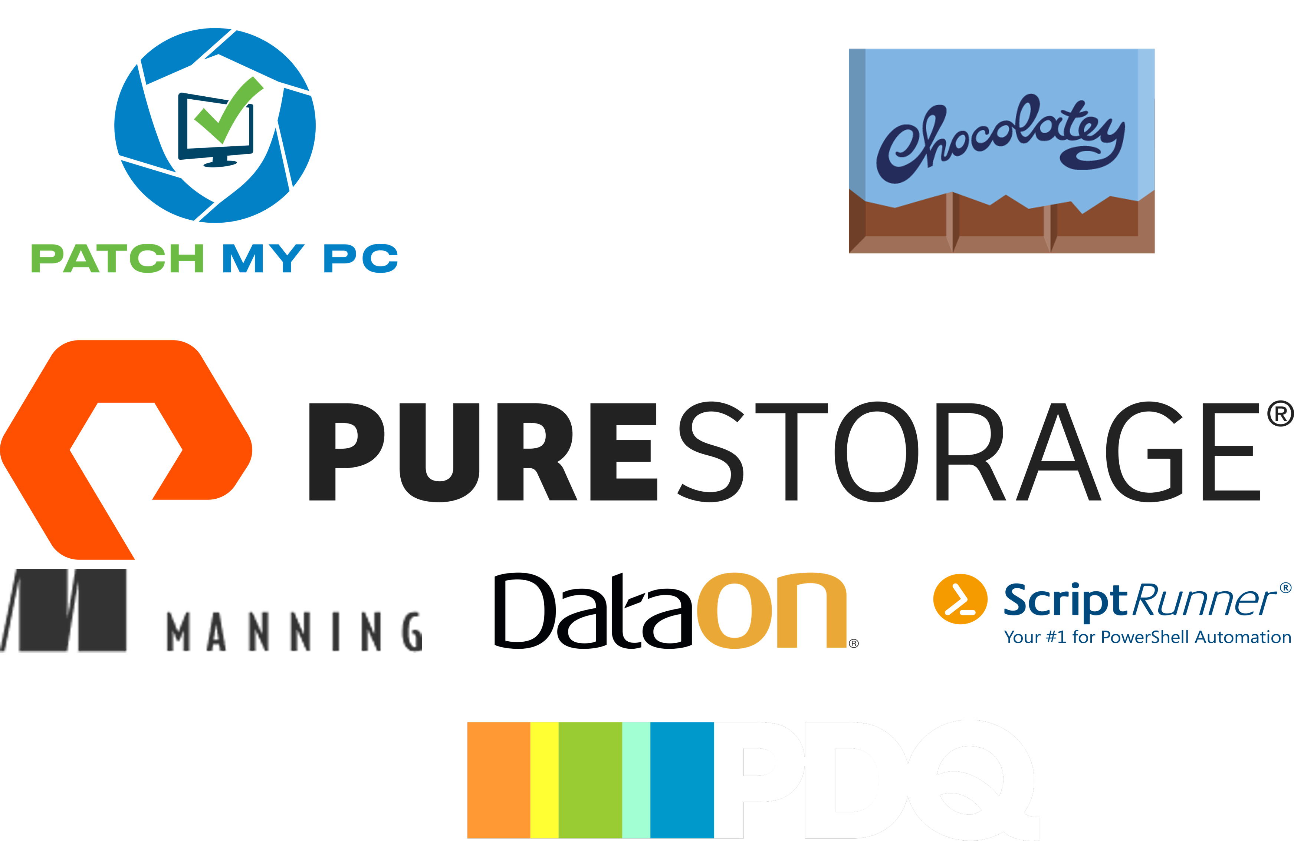

Slide 3

Thank you iQmetrix
iQmetrix’s purpose is to Create Great Experiences. We aim to enrich the lives of our employees, our partners, our clients, and their customers by enabling a wireless retail experience that’s as human as our fundamental need for connection.

Slide 4

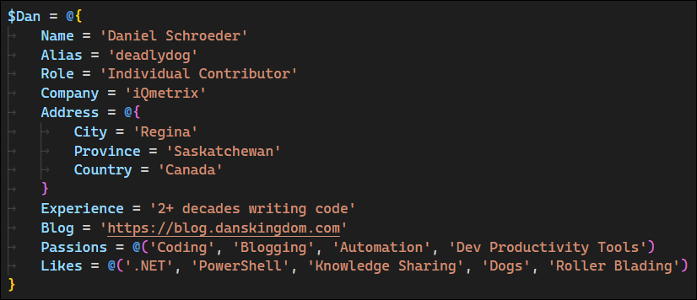
About Dan
Notes:
- @deadlydog
- Individual Contributor at iQmetrix
- Writing software for over 2 decades
- Blogging for over a decade: https://blog.danskingdom.com
- Passionate about automation and developer productivity tools

Slide 5
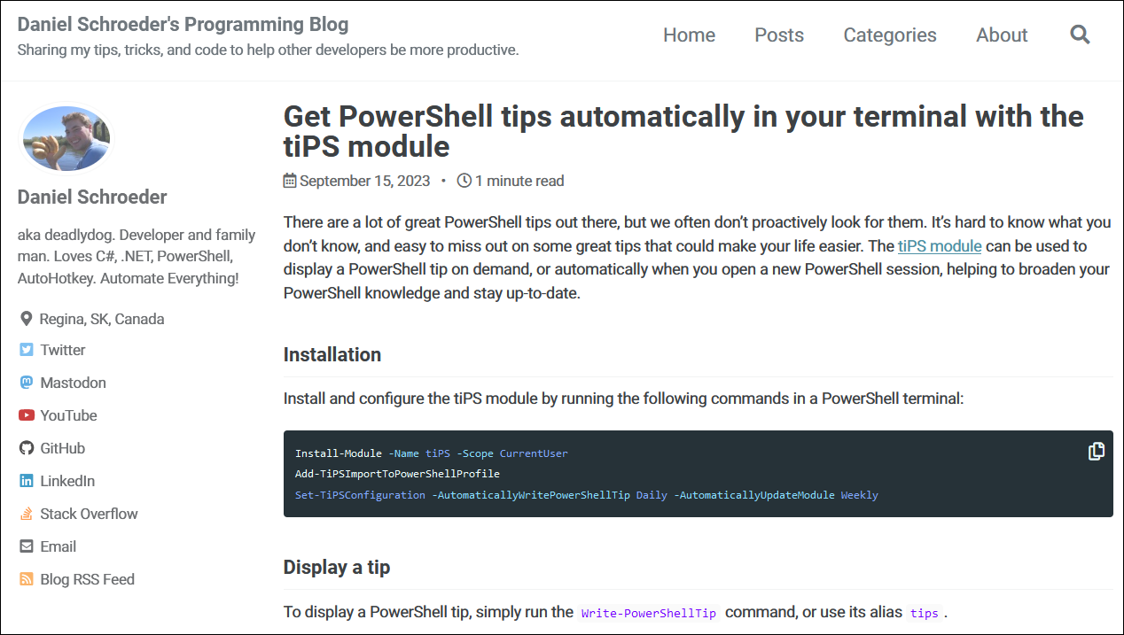
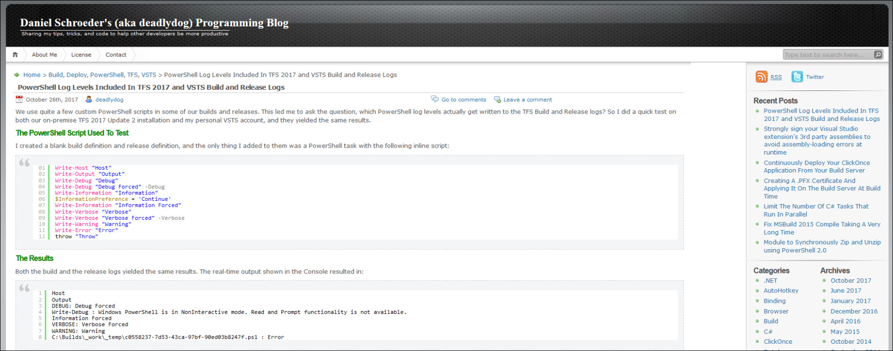
Notes:
- This is what my blog looks like now
- and before 2020
- If either look familiar, then you’ve likely visited my blog before

Slide 6
Agenda
Why use modules?
Why automate publishing?
How to automate publishing?
Demo
Wrap up

Slide 7
Why use modules?
Easy to install
Easy to update
Easy to use
Install-Module (Install-PSResource)
Update-Module (Update-PSResource)
& C:\Some\Path\Script.ps1
Notes:
- Install the module with a single command
- Don’t have to worry about where the script is stored. No tracking down a file share, GitHub gist, git repository, etc.
- Update to the latest version with a single command
- Don’t have to inspect script contents to ensure you have the latest version
- Call the cmdlets without worrying about where the script’s file path is

Slide 8
Evolution to modules
1. Run commands in the terminal
2. Put commands into a script
3. Put Params on the script
4. Turn the script into a module
Migrating from scripts to modules is an iterative process
Not every script needs to be a module
Notes:
- Scripts that you find yourself using all of the time or commonly sharing. with others are good candidates to turn into a module

Slide 9
Publishing a module is easy
Publish-Module (Publish-PSResource)
-Path C:\PathTo\MyModule –NuGetApiKey *****
-Repository MyInternalPowerShellFeed

Slide 10
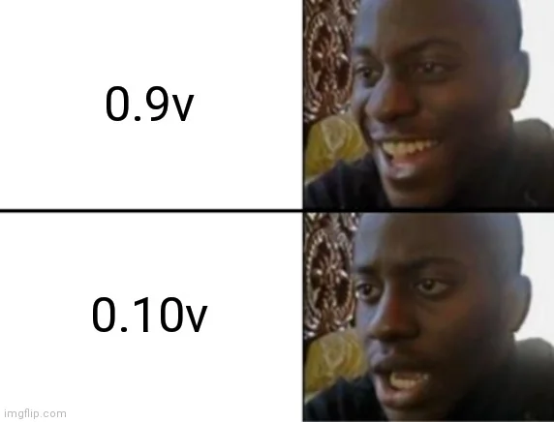
Oh right, version number
Notes:
- Need to update the version number in the module manifest .psd1 file

Slide 11
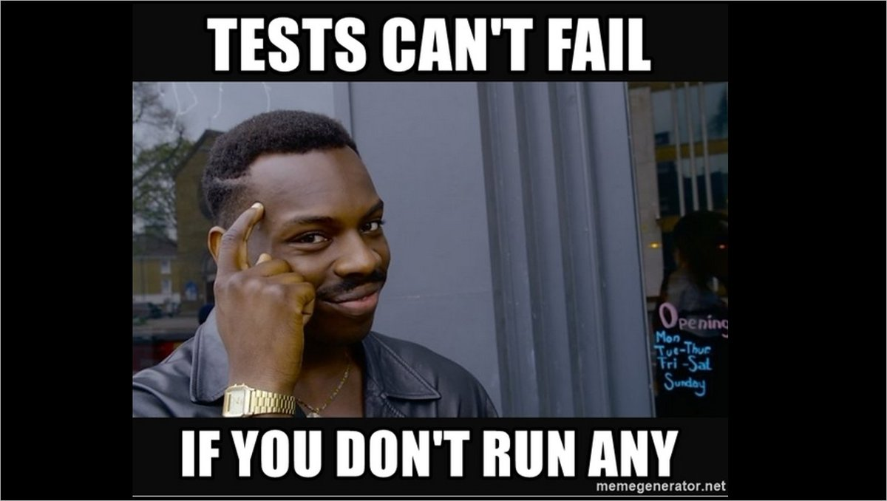
Oh right, tests
Notes:
- Someone files a bug for a use case you know you wrote a test for….. Oh, I forgot to run the tests before publishing the new version *facepalm*

Slide 12
Let’s write a deployment script!

Slide 13
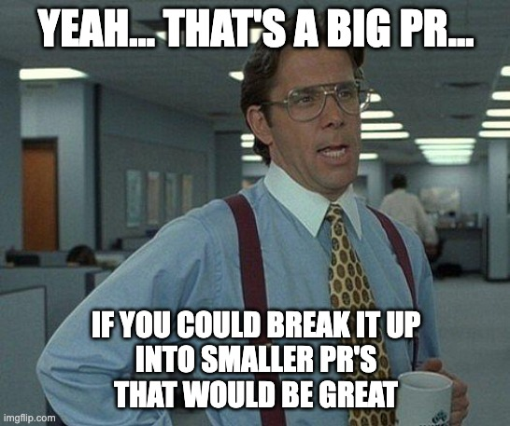
Don’t forget code reviews

Slide 14
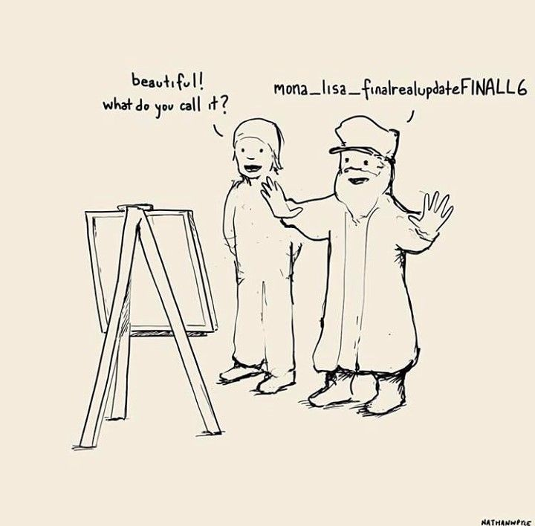
And source control
Notes:
- Source control should be table stakes; allows you to see who made what changes when and why, and easily rollback if there are issues.
- Creating a git repo for every little script can be a lot of overhead, so create a General Scripts dumping ground repo, and move scripts into their own repo as they grow.

Slide 15
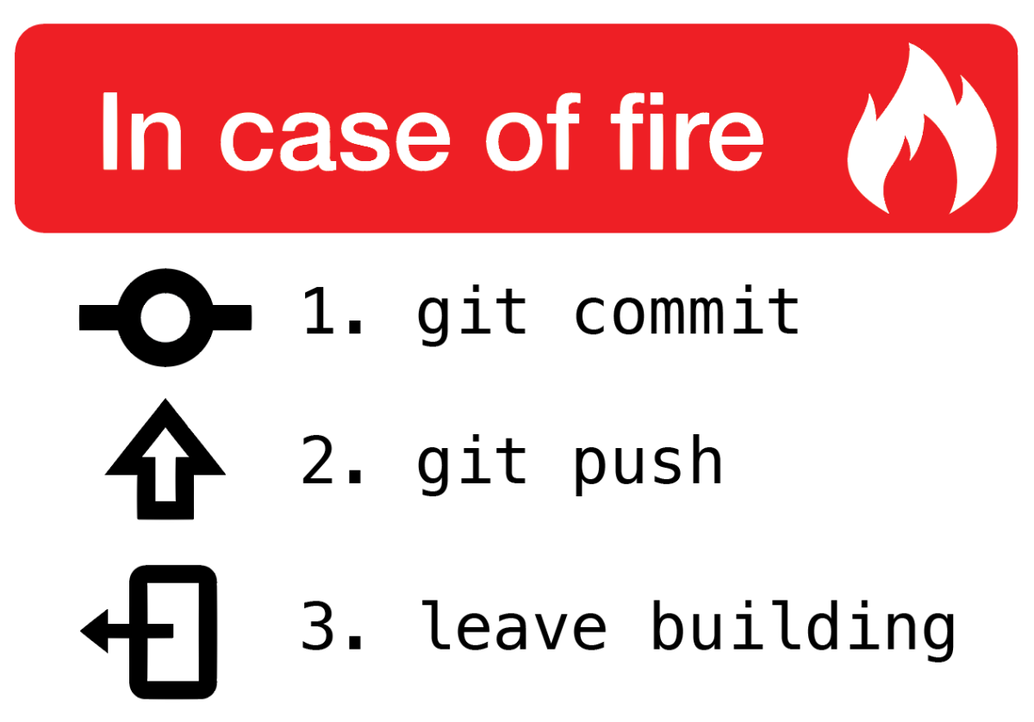
Oh right, push code up
Notes:
- If you forget to push your code up, it only exists on your local machine
- What if your hard drive dies, or your colleague wants to make changes

Slide 16
Publish from the right branch
Notes:
- Accidentally manually publish a feature branch instead of the main branch

Slide 17
Title

Slide 18
Security
Separate the deployer from the code writer for audits (PCI, SOC, etc.)

Slide 19
Title

Slide 20
Why use pipelines
Forces good practices:
Version control
Enables branch policies for code reviews
Only push from the main branch by default
Code must be pushed to remote repo

Slide 21





Why use a pipeline?
Notes:
Consistency and repeatability
Logging (persisted)
Visibility
Security
Auditing
Notifications
Not just for deployments; can be useful for other things like cron jobs or manually ran scripts

Slide 22

Why use pipelines?
Notes:
- Manually publishing scripts is like requiring your team to see a Magic Eye image
- Not everyone can figure out how to do it
- Even if they can, it often takes them a while (install dependencies, etc.)

Slide 23
Title

Slide 24
Demo
Let’s publish a new module!

Slide 25
Pipelines aren’t perfect
Not all sunshine and rainbows
Notes:
- Pipelines have their own drawbacks:
- Sometimes MS updates their cloud agents and breaks something you depend on.
- Actions sometimes get updated or deprecated and break your pipeline.
- Email notifications for pipelines that were never approved after they expire.

Slide 26
Recap
A list of all the reasons why to use pipelines

Slide 27



THANK YOU
Please review this session
twitter.com/deadlydog
github.com/deadlydog
blog.danskingdom.com

Slide 28
Heading

Slide 29
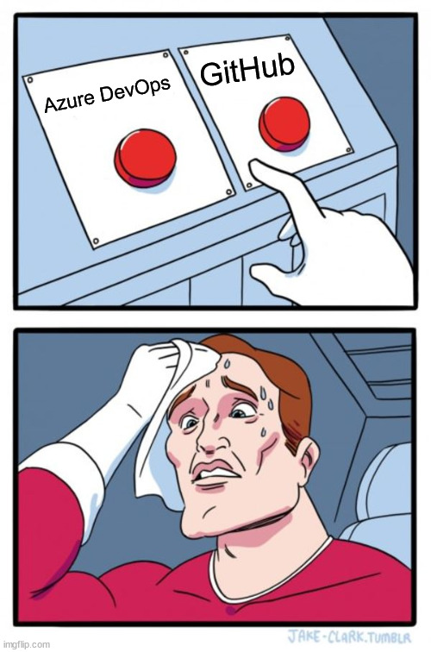
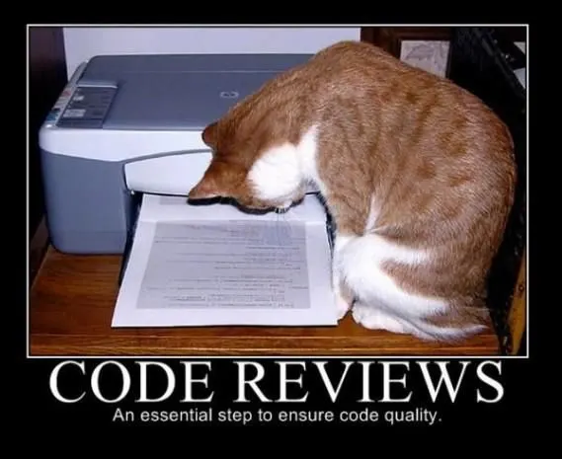

Slide 30

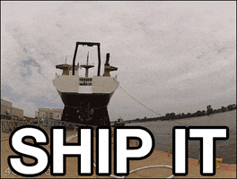
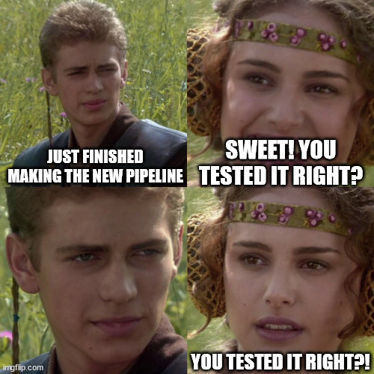

Slide 31
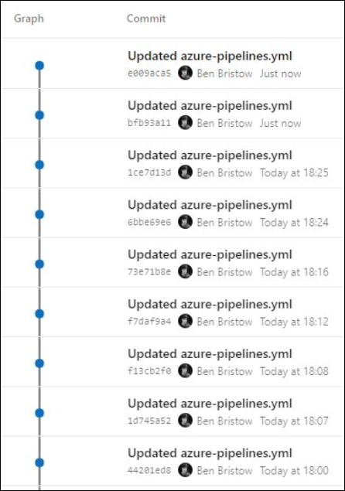
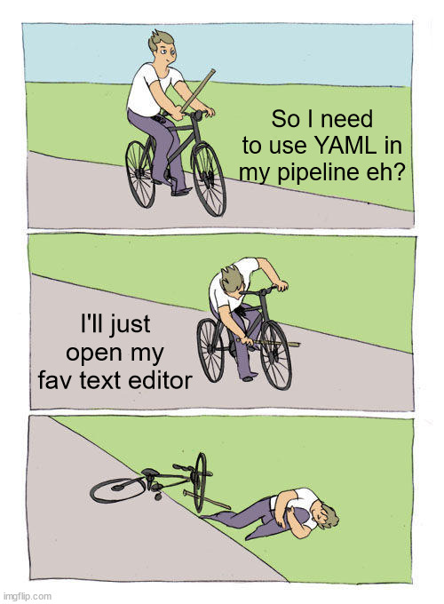


Slide 32
